Slide 1


Slide 2
Netflix Shows And Movies : Exploratory Analysis And Data Visualization
NETFLIX
Prepared By
Yash Pandey

Slide 3

Project Description
Dive into Netflix's vast collection of movies and TV shows.
Dataset includes essential details: titles, directors, casts, release years, ratings, and durations.
Initial steps involve dataset loading and feature engineering.
Uncover top insights, trends, and correlations within Netflix's content.
Gain valuable understanding of viewer preferences and engagement.
Inform strategic decisions and content curation efforts.

Slide 4

Table Of Content
1
1
Understanding the Scope
2
Variable Description
3
Data Cleaning
4
Data Analysis
5
Data Visualization

Slide 5
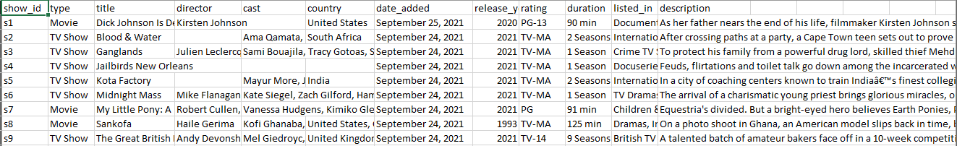
Understanding the Scope
The objective of this analysis is to gain insights into the vast array of movies and TV shows available on Netflix. By exploring various attributes such as genres, release dates, ratings, and durations, we aim to uncover patterns and trends within Netflix's entertainment catalog.
Variable Description
show_id: Unique identifier for each movie or TV show.
type: Indicates whether the entry is a movie or a TV show.
title: The title of the movie or TV show.
director: The director(s) of the movie or TV show.
cast: The cast members appearing in the movie or TV show.
country: The country or countries where the movie or TV show was produced.
date_added: The date when the movie or TV show was added to Netflix.
release_year: The year when the movie or TV show was released.
rating: The rating assigned to the movie or TV show (e.g., PG, PG-13, R).
duration: The duration of the movie or TV show (in minutes).
listed_in: The genre(s) or category/categories associated with the movie or TV show.
description: A brief description or summary of the movie or TV show

Slide 6
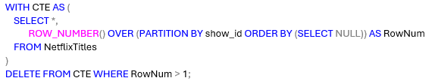
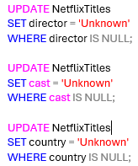
Data Cleaning
Dealing with Duplicates: Detect and remove any duplicate entries in the dataset to ensure data integrity.
Handling Missing Values: Identify and handle missing values in the dataset, either by imputation or removal.

Slide 7
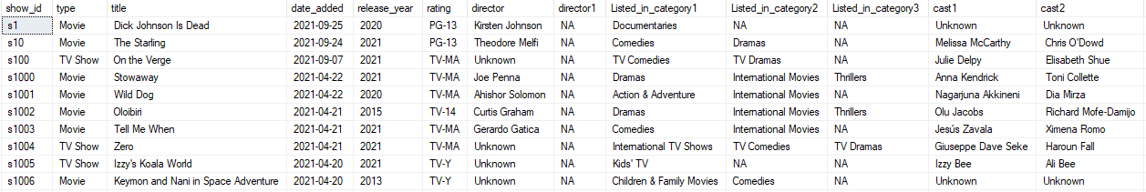
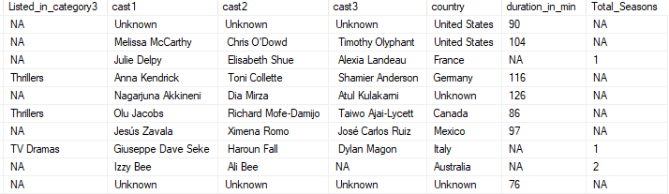
Standardizing Formats: Standardize formats for variables such as dates, ratings, and durations to facilitate analysis.
Ensuring Consistency & Addressing Outliers: Ensure consistency in categorical variables such as genres, countries, director and cast to avoid ambiguity. Investigate and handle outliers, if present, to prevent them from skewing the analysis results.
By executing these data cleaning steps, our goal is to create a clean and reliable dataset for further analysis. For clarity, we partitioned the NetflixTitles table into two sub-tables after standardizing the director, listed_in, and cast columns. These two sub-tables are NetflixTitles_Movies and NetflixTitles_TV_Shows.

Slide 8
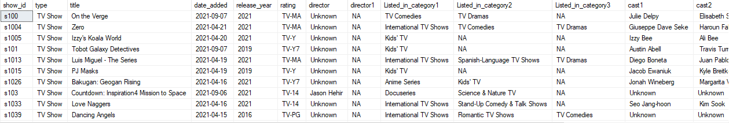
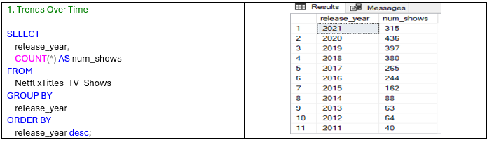
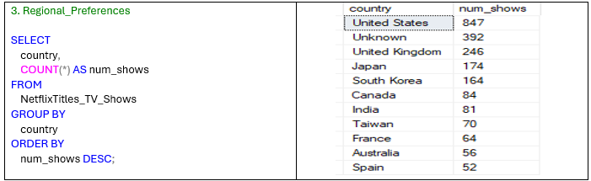
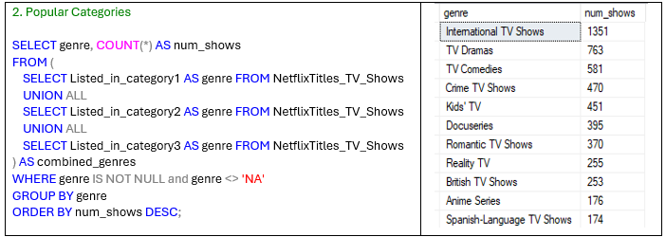
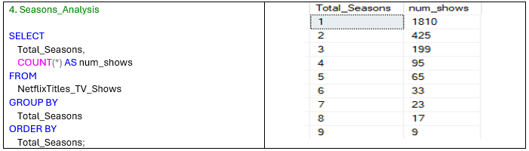
NetflixTitles_Tv_Shows

Slide 9
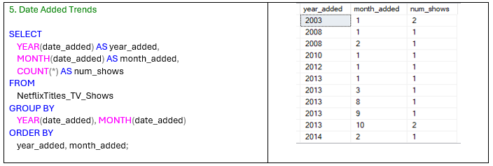
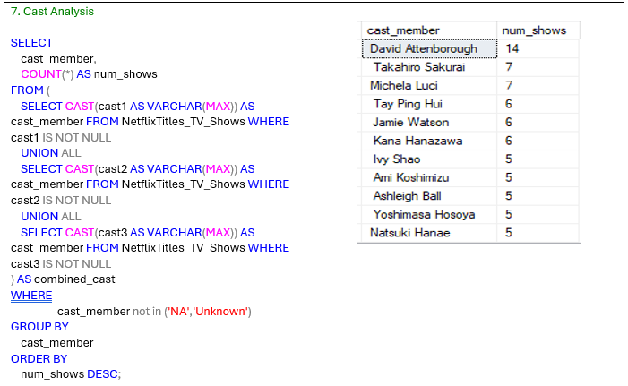
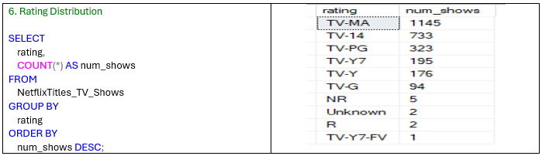

Slide 10
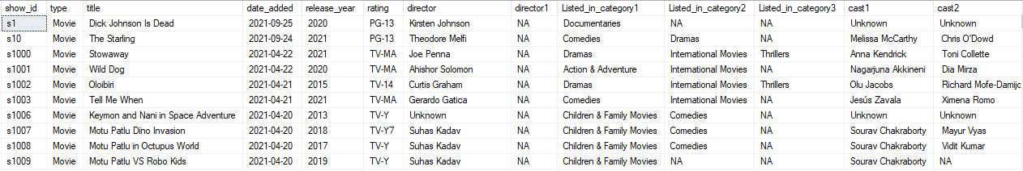
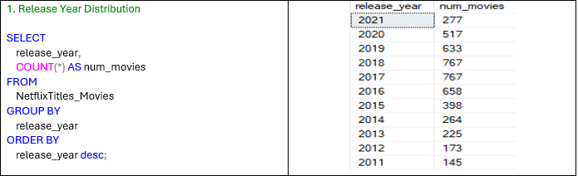
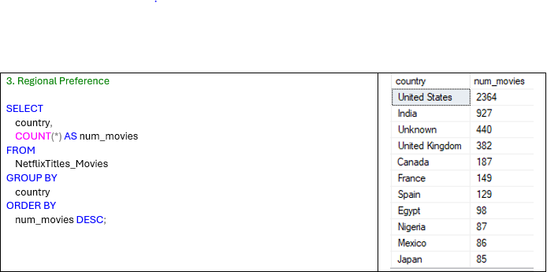
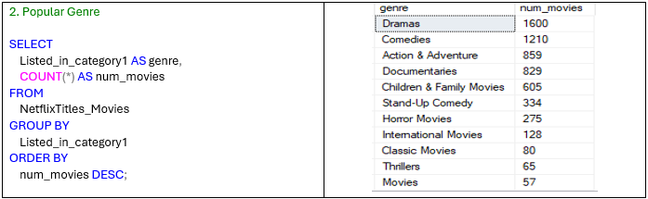
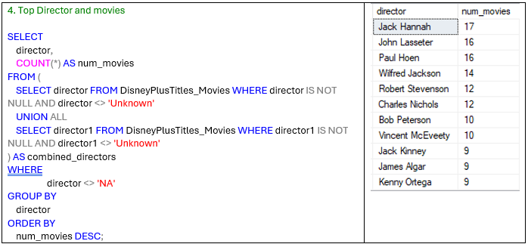
NetflixTitles_Movies

Slide 11
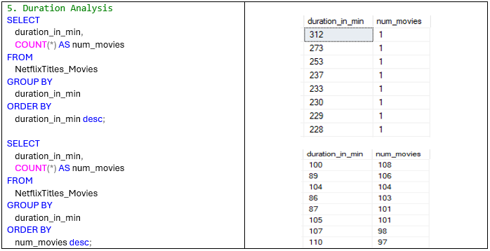
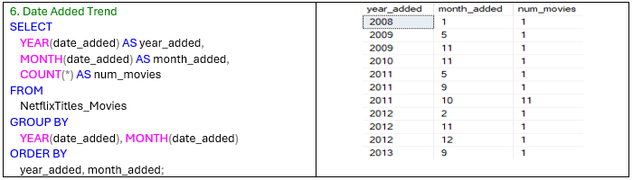

Slide 12
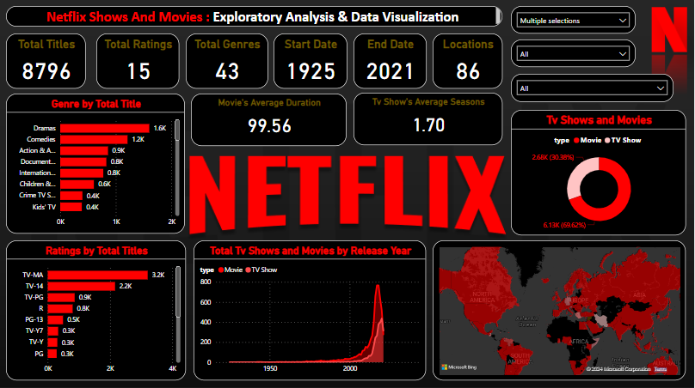
NETFLIX

Slide 13
Thank You

